Slide 3
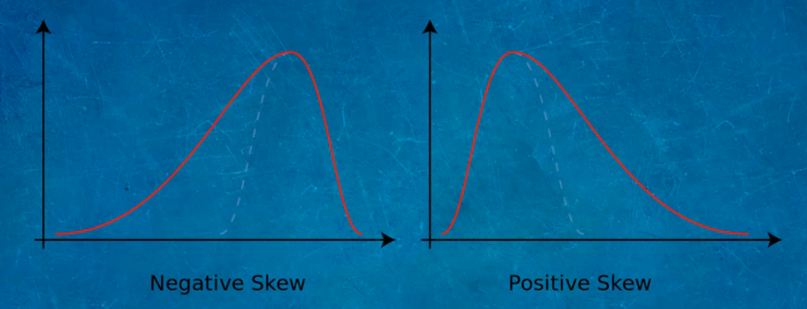

Slide 8
Euclidean Distance
Discrete values
Humidity | temperature | Run
30 | 25 | +
48 | 40 | -
80 | 64 | -
28 | 30 | +
50 | 60 | -
x = <humidity, temperature>
New instance x_{q} = <40, 30, run=?? > We can run inside(+) or outside (-)
1-NN (x1)
Answer run inside(+)
2-NN (x1,x4)
Answer run inside(+)
3-NN (x1,x2,x4)
Answer run inside (+)
4-NN (x1,x2,x4,x5)
Answer run inside (+)
5-NN
Answer run inside(-)

Slide 9
Euclidean Distance
Real values
Humidity | temperature | Rainfall
30 | 25 | 5.1
48 | 40 | 15.5
80 | 64 | 20.2
28 | 30 | 3.2
50 | 60 | 12.0
1-NN (x1)
Rainfall = 5.1
2-NN (x1,x4)
Rainfall = (5.1+3.2)/2 = 4.15
3-NN (x1,x2,x4)
Rainfall = (5.1+15.5+3.2)/3
= 7.9
4-NN (x1,x2,x4,x5)
Rainfall = (5.1+15.5+3.2+12.0)/4 = 8.95
5-NN (x1,x2,x3, x4,x5)
Rainfall = (5.1+15.5+3.2+20.2+12.0)/5 =
11.2
x = <humidity, temperature>
New instance x_{q} = <40, 30, Rainfall =?? >

Slide 10
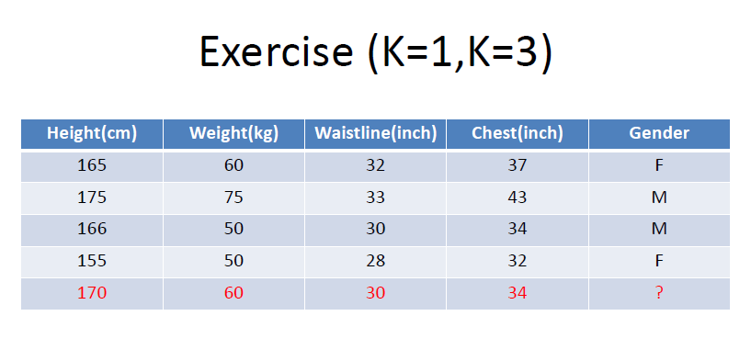





Slide 11


Slide 12
